Slide 1
Introduction to APIs
by BPI

Slide 2
Introduction to APIs
What You’ll Learn
What is an API and RESTful APIs
HTTP
JSON and Serialization w/ Jackson
Building a REST API

Slide 3
Introduction to APIs
What We’ll Discuss
Project Structures
Building a minimal RESTful API with Spark Java

Slide 4
Introduction to APIs
Project Structure
In the early 2000s, enterprise projects were getting massive, consequently, teams were also growing in size. Software stability and maintainability was prioritized instead of speed. Productivity slowed down as spaghetti code became an issue. To solve this problem, the industry adapted proper structuring.
Applications are now separated into layers with each layer having one responsibility.
Applications became easier to test, to maintain, and to scale.
There’s no one rule when structuring applications. There are multiple software architectural patterns that exist. One of the most common structure is the N-Tier Layered Architecture

Slide 5
Introduction to APIs
Layered Architecture (N-Layer Architecture)
A design pattern focused on organizing applications into multiple different layers, with each layer focused on one responsibility.
Separation of concerns is the key idea.
It promotes Scalability as it allows developers to upgrade individual components without affecting other components.
It promotes Maintainability as it becomes easier to navigate the application structure as components are organized and easily manageable.

Slide 6
Introduction to APIs
Other Patterns
MVC pattern or the Model-View-Controller pattern is a pattern that introduces separation of concern. The components are grouped into Controllers which handle user input and routing, Models that are concerned with the business logic and the data involved, and the View which presents the model and handles user interaction.
Another pattern is the Three-Tier Architecture which is composed of the Presentation Layer, the Application Layer, and the Data Layer.

Slide 7
Introduction to APIs
Backend Components
N-Layer architecture is common in RESTful APIs.
Here are the concepts that you’ll see the backend application of RESTful APIs
Config
Controller
Service
Repository
Model
DTO
Exception
Util

Slide 8
Introduction to APIs
Typical Structure of an N-Layer Architecture
/config
Contains configuration like server configuration, database configuration, filters, or any code that would be necessary for the setup of the application.
/controller
Contains controller classes that serve as the entry point for HTTP Requests.
/service
Contains the business logic for the whole application.
/repository
Contains data access logic.
/model
Contains the domain objects, or the primary entities in the application
/dto
Contains Data Transfer Objects, or objects that are used to represent the application models during API communication.
/exception
Contains exception classes.
/util
Contains Utility classes for shared use across the application.

Slide 9
Introduction to APIs
Config
Code that holds application configuration and setup.
This could include security setup, filters/interceptors, dependency wiring, database configuration, any other configuration or registration required by the framework.
Keywords: Set up, config

Slide 10
Introduction to APIs
Controller
Handles HTTP requests or client interactions.
Declare routes, accept request payload, input validation, returns response.
Calls the service layer
It should NOT contain business logic or complex processing.
Keywords: Routing, API endpoints, Request & Response

Slide 11
Introduction to APIs
Service
Contains the business logic and application’s core process.
Calls the repository layer
Keywords: Business logic, processes, brain of the application

Slide 12
Introduction to APIs
Repository (Data Access Layer)
Handles the interaction with the data sources.
Responsible for querying the database and database persistence.
Keywords: database, repositories, data access layer, DAO (Data Access Object)

Slide 13
Introduction to APIs
Model (Domain / Entity)
Represents the core business entities.
The objects or entities used by the application.
Keywords: models, entities, objects

Slide 14
Introduction to APIs
DTO (Data Transfer Object)
Represents the data moving to-and-from the application.
Commonly used as a representation of an entity as the entities themselves should not be passed or exposed to other layers.
Its primary purpose is to hide sensitive or unnecessary data which in turn saves memory.
Keywords: carrier, transfers data, representation

Slide 15
Introduction to APIs
Exception
Contains the application’s custom exceptions and global exception handling.
Keywords: Exception handling, error handling

Slide 16
Introduction to APIs
Util
Utility classes that can be used across all layers and contains logic that do not count as “core business” logic.
It can contain validation, formatting, parsing, file utilities, or any other helper classes.
Should not be dependent on other layers.
Keywords: Utility, Helper

Slide 17
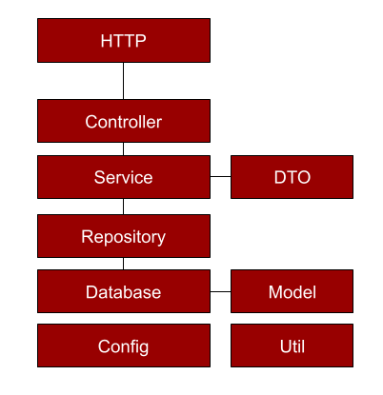
Introduction to APIs
*this is only a visualization

Slide 18
Introduction to APIs
Introduction to Spark Java
A lightweight and expressive framework for creating web applications allowing for fast development and minimal boilerplate code.

Slide 19
Introduction to APIs
Spark Java to Spring Boot
Spark Java is a framework designed to be like a Domain-Specific-Language, a language specialized in solving one problem, for Web applications. It’s designed in a way that it needs minimal configuration unlike Spring Boot which, although offers a lot of automatic configuration, still requires a lot of setup even for a minimal web server application.
In this lecture, we’re going to structure our Spark Java application like a Spring Boot application so that the architecture and concepts are carried over even though the framework changes.

Slide 20
Introduction to APIs
Creating a Basic Application (1)
In this lecture, we’re going to structure our Spark Java application like a Spring Boot application as much as possible so that the architecture and concepts are carried over even though the framework changes.
Let’s start with creating a minimal Spark Java Server

Slide 21
Introduction to APIs
Creating a Basic Application (2)
Create a basic Maven Project with Spark Java imported. In your Main class, add the following import.
Note that it is a static import. It allows us to use all static methods inside the Spark class.
import static spark.Spark.*;

Slide 22
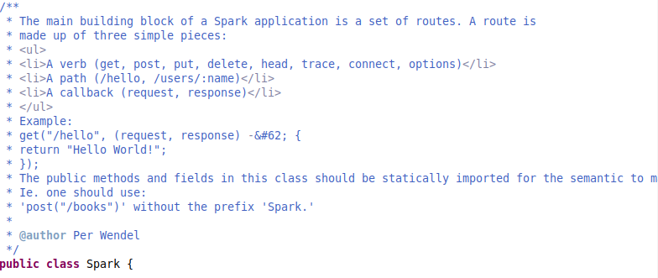
Introduction to APIs
Creating a Basic Application (3)
The documentation for the Spark class indicates that this is intended as it allows developers to setup the server intuitively.

Slide 23
Introduction to APIs
Creating a Basic Application (4)
Let’s declare a port for our application; A port is a virtual point in our host that essentially tells where an application is located.
Let’s create this application at port 4567 by calling the static method: port(int)
The port must be added BEFORE any routes.
public class Main {
private static final Logger logger = LoggerFactory.getLogger(Main.class);
private static final ObjectMapper mapper = new ObjectMapper();
public static void main(String[] args) {
// Start server on port 4567 (default)
port(4567);

Slide 24
Introduction to APIs
Creating a Basic Application (5)
Finally, we add routes or endpoints to our web application. These are paths in our application to which a client application can invoke our API functionalities.
Let’s create a route that will quickly allow us to know if the application is up and running. Pick a name for the path and call the get(String, Route) method.
// We create a route for checking if the server is active.
get("/check-connection", (req, res) -> {
res.type("application/json");// define the MIME type of the response
// we're telling the client that the response
// is of JSON format
// return a map (A map is basically a JSON formatted object)
Map<String, String> response = new HashMap<>();
response.put("status", "Server is running");
return JsonUtil.toJson(response);
});
Note: the second parameter of get (and other methods) is a class called Route which is what we call a Functional Interface. It’s essentially a parameter that is also a function. We use it to pass

Slide 25
Introduction to APIs
Creating a Basic Application (5)
Let’s add a route for a POST method.
// An example POST method that returns the payload that you send.
post("/echo", (req, res) -> {
res.type("application/json");
// Just return the request body as the response
return req.body();
});

Slide 26
Introduction to APIs
Quick Cheat Sheet for Spark Java
Below is all you need to know for creating a simple Spark Java Endpoint
// This is a PUT endpoint
// put = method
// /persons = path
// :id = uri parameter, this indicates that this is a dynamic value
// req = HTTP request sent by the client
// res = HTTP response to be returned by this path, you can set headers here
put("/persons/:id", (req, res) -> {
// this is a query param. it looks like this: /persons/1?name=value
String name = req.queryParams("name");
// we get the value of :id
String paramId = req.params("id");
// we deserialize the JSON into our Java Object
Object payload = JsonUtil.fromJson(req.body(), Person.class);
return JsonUtil.toJson(payload);
});

Slide 27
Introduction to APIs
Exercise 1 - Individual (M7_ACTIVITY1)
Clone the repository https://github.com/jpmenguito/api-training (or sync the repository if you already cloned it)
Import / Run the project named m7_activity1 using Eclipse or your IDE.
If you cannot run it, feel free to copy the code into your project, just make sure you have the proper Maven Dependencies. (See Module 7 Prerequisites.pdf)
Requirements:
Inside Main.java, implement a GET and POST endpoint for the entity Movie
GET movies should retrieve all movies
POST movies should accept a Movie object from the request and save it inside the repository.

Slide 28
Introduction to APIs
Exercise 1 - Individual (M7_ACTIVITY1)
m7_activity1 is already configured to have a database with an already existing Movie for the model, MovieRepository for the DAO.
Use the functions of MovieRepository to satisfy the requirements below.
NOTE: edit /src/resources/META-INF/persistence.xml according to your computer’s database setup.
Requirements:
Inside Main.java, implement a GET and POST endpoint for the entity Movie
GET movies should retrieve all movies
POST movies should accept a Movie object from the request and save it inside the repository.

Slide 29
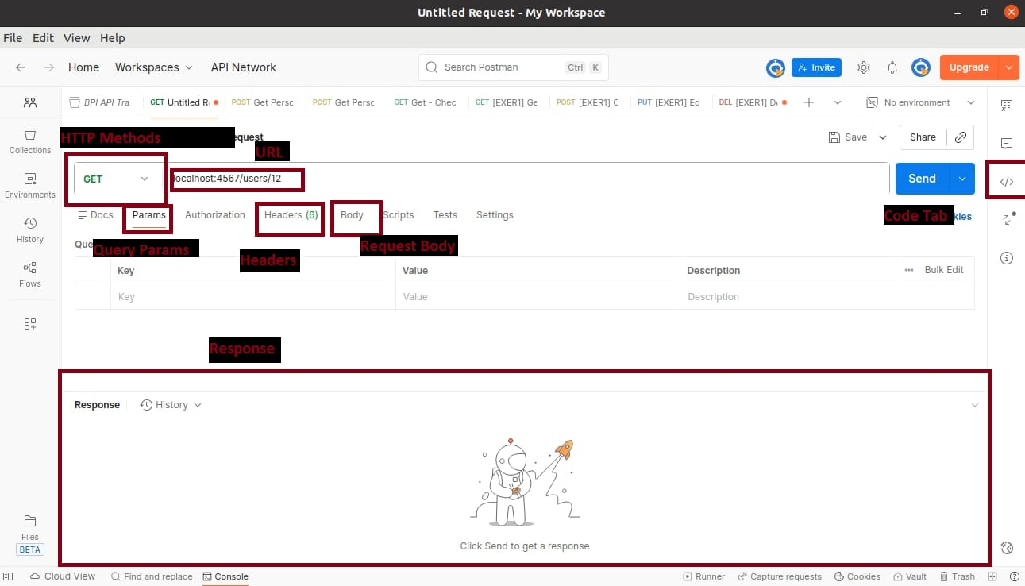
Introduction to APIs
Postman Quick Guide

Slide 30
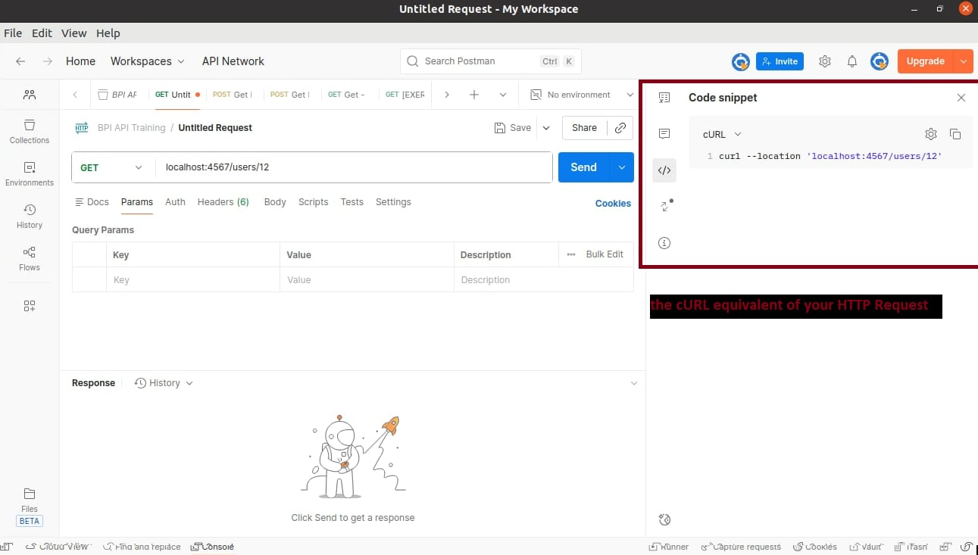
Introduction to APIs
Postman - Code Tab

Slide 31
Introduction to APIs
cURL (Client for URLs)
A powerful open-source command-line tool for API testing (among other things).
It’s similar to Postman and Bruno.
curl -X POST https://api.example.com/data -H "Content-Type: application/json" -d '{"key": "value"}

Slide 32
Introduction to APIs
Exercise 2 - Individual (M7_ACTIVITY2)
Clone the repository https://github.com/jpmenguito/api-training (or sync the repository if you already cloned it)
Import / Run the project named m7_activity2 using Eclipse or your IDE.
If you cannot run it, feel free to copy the code into your project, just make sure you have the proper Maven Dependencies. (See Module 7 Prerequisites.pdf)

Slide 33
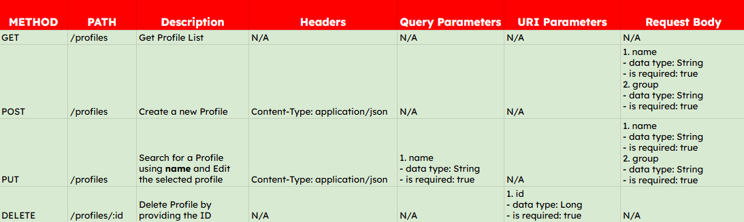
Introduction to APIs
Exercise 2 - Individual (M7_ACTIVITY2)
Refer to the API specifications below:

Slide 34
Introduction to APIs
Exercise 2 - Individual (M7_ACTIVITY2)
Given the API specifications, test the API using Postman or Bruno.
Do the steps outlined below.
AFTER each step, copy the cURL command equivalent of your request and paste it in a .txt file.
No code change needed. Just run the application (m7_activity2)
Get Profile List.
Create a profile using your name and group.
Edit the profile of Emilio Aguinaldo and update the name to Antonio Luna and the group name to Illustrados.
Delete the profile of Andres Bonifacio.
Copy and paste the Response of Step #4.

Slide 35
Introduction to APIs
Adding Structure to our API
Let’s improve our basic API by refactoring our code and separating them into different classes.
A structured RESTful API must at least have a Controller class, a Service class, and a Repository class and a Model class.
For now, let’s create PersonController, PersonService

Slide 36
Introduction to APIs
Controller
Create a PersonController class with a dependency PersonService. Create a constructor initializing the dependency.
public class PersonController {
private final PersonService personService;
// initialize dependencies
public PersonController (PersonService personService) {
this.personService = personService;
}

Slide 37
Introduction to APIs
Controller
add a method called registerRoutes() which should contain all the routes we previously added in our Main class
public void registerRoutes() {
// We create a route for checking if the server is active.
get("/check-connection", (req, res) -> {
res.type("application/json"); // define the MIME type of the response
// we're telling the client that the response
// is of JSON format
// return a map (A map is basically a JSON formatted object)
Map<String, String> response = new HashMap<>();
response.put("status", "Server is running");
return JsonUtil.toJson(response);
});

Slide 38
Introduction to APIs
Controller
let’s add a GET and POST route that calls the PersonService
get("/persons", (req, res) -> {
ResponseDTO<List<PersonDTO> > response = new ResponseDTO<>();
res.type("application/json");
response.setStatus(ResponseStatus.SUCCESS);
response.setData(this.personService.listPersons() );
return JsonUtil.toJson(response);
});

Slide 39
Introduction to APIs
Controller
let’s add a GET and POST route that calls the PersonService
post("/persons", (req, res) -> {
ResponseDTO<PersonDTO> response = new ResponseDTO<>();
if(req.body() == null || req.body().isBlank() ) {
response.setStatus(ResponseStatus.ERROR);
response.setMessage("Payload cannot be blank!");
return JsonUtil.toJson(response);
}
PersonDTO personDTO = JsonUtil.fromJson(req.body(), PersonDTO.class);
this.personService.addPerson(personDTO);
response.setStatus(ResponseStatus.SUCCESS);
response.setData(this.personService.getPersonById(personDTO.getId() ) );
return JsonUtil.toJson(response);
});

Slide 40
Introduction to APIs
DTO (Data Transfer Object)
In our routes, we used two DTOs called ResponseDTO and PersonDTO. DTOs are simple objects used to transfer/hold data.
We use ResponseDTO as the standard response representation of our API. PersonDTO is the equivalent of our model.

Slide 41
Introduction to APIs
ResponseDTO
Create a ResponseDTO that can hold any data type for the field data
Add getters and setters.
public class ResponseDTO<T> {
private ResponseStatus status;
private String message;
private T data; // this means that this class
// can hold ANY "data" of type "T"
// if we use ResponseDTO<String> res = new ResponseDTO<String>();
// res.getData() will be type String

Slide 42
Introduction to APIs
ResponseStatus (Enum)
Create a simple Enum for the status
public enum ResponseStatus {
SUCCESS,ERROR
}

Slide 43
Introduction to APIs
PersonDTO
Create a PersonDTO that contains all the fields (from Person) that we want to expose in our API. Add constructors, getters and setters, and a special method we use to convert PersonDTO to Person
public class PersonDTO {
private Long id;
private String name;
private Integer age;
private Boolean isAwesome;
public PersonDTO() {}
public PersonDTO(Long id, String name, Integer age, Boolean isAwesome) {
this.id = id;
this.name = name;
this.age = age;
this.isAwesome = isAwesome;
}

Slide 44
Introduction to APIs
PersonDTO
public PersonDTO(Person personEntity) {
this.setId(personEntity.getId() );
this.setName(personEntity.getName() );
this.setAge(personEntity.getAge() );
this.setIsAwesome(personEntity.getIsAwesome() );
}
// we call this method to return an instance of Person
public Person toEntity() {
Person person = new Person();
person.setId(this.getId() );
person.setName(this.getName() );
person.setAge(this.getAge() );
person.setIsAwesome(this.getIsAwesome() );
return person;
}

Slide 45
Introduction to APIs
PersonService
Create the PersonService class
public class PersonService {
// this is just a holder of all the Persons that we create
// ideally this should just be a repository
private final List<Person> personList = new ArrayList<>();
// GET ALL Persons
public List<PersonDTO> listPersons() {
// return a list of PersonDTO
return personList.stream()
.map(x -> new PersonDTO(x) )
.collect(Collectors.toList() );
}
// GET One Person by id
public PersonDTO getPersonById(Long id) {
return personList.stream()
.filter(x -> x.getId().equals(id) )
.findFirst()
.map(x -> new PersonDTO(x) )
.orElse(null);
}

Slide 46
Introduction to APIs
PersonService
// CREATE Person
public List<PersonDTO> addPerson(PersonDTO personDTO) {
// add person
personList.add(personDTO.toEntity() );
return personList.stream()
.map(x -> new PersonDTO(x) )
.collect(Collectors.toList() );
}

Slide 47
Introduction to APIs
Main.java
Modify Main.java and only instantiate the Service and Controller classes.
public static void main(String[] args) throws Exception {
// Start server on port 4567 (default)
port(4568);
// instantiate the service
PersonService personService = new PersonService();
// instantiate the controller while plugging in the personService
PersonController personController = new PersonController(personService);
// call the registerRoutes to register all declared routes
personController.registerRoutes();
logger.info("Server started at port {}", port() );
}

Slide 48
Introduction to APIs
Exercise 3 - Individual (M7_ACTIVITY3)
Modify your M7_ACTIVITY1 and refactor the contents of Main.java.
Create a MovieController, MovieService and put them into different packages.
MovieController has a dependency on MovieService and should call the service methods for business logic. It should also have the method void registerRoutes() containing all the routes.
MovieService should call the MovieRepository methods. (And instantiate the EntityManager)
Your Main.java should just contain the port and the instantiation of MovieService and MovieController only.
Call MovieController.registerRoutes() in Main.java.

Slide 49
Introduction to APIs
Group Project Requirements - M7
Convert your M6 project into a RESTful API using Spark Java
Create a BookController class.
Create a route that utilizes/represents all the M6 functionalities:
Display All Books
Display Available Books
Display All Borrowed Books
Borrow Book
Return Book
Add Book
Remove Book
Update Book
All interactions (input and output) must be made through the API.
Create an API specification for your API. It must at least indicate the HTTP Method, Resource Path, Query Parameters, URI Parameters, Request Body, and the Response Body.
Bonus Points:
+1 for Clever Design
+1 for Validation
+1 for Proper Use of HTTP Statuses

